Slide 1
Learn R-Studio from a Working Knowledge of Excel and Up Your Analytics Game
don-E Merson
Scholarship Universe
Masters Student-School of Information

Slide 2
Who am I?
don-E Merson
Scholarship Universe- Programmer/Architect
Masters Student –School of Information
Ph.D. (Accepted but not yet)
Interests
Excel
Data Mining
Statistics
Machine Learning
Economics

Slide 3
Who are you?
Your name
Where on campus?
What do you do?
Experience in Excel
Experience in Programming
Experience in R
Experience in Statistics

Slide 4
Materials
Share Power Point in Box
https://arizona.box.com/s/m0shoa7nyapa8fhqfsdbq8262ueqtqm3

Slide 5

How this class will work
This based on learning techniques from
Notes:
https://www.coursera.org/learn/learning-how-to-learn

Slide 6
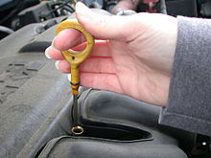
The order of modules
Quiz on things you don’t know
Primes you for important ideas
Opened answered-not graded
I talk about what we are going to learn
You will play along as I talk
You can skip ahead
You take the same quiz again
5 minute break
Quiz is dipstick, not measuring stick
Notes:
https://www.google.com/url?sa=i&rct=j&q=&esrc=s&source=images&cd=&cad=rja&uact=8&ved=0ahUKEwir3ZKI4YLXAhUjsVQKHeBmACYQjRwIBw&url=https%3A%2F%2Fen.wikipedia.org%2Fwiki%2FDipstick&psig=AOvVaw2m2Vt19R6eJtK6opcPn7_e&ust=1508711121590407

Slide 7
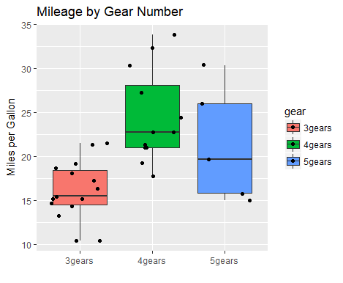
Our modules
You will do this
We might skip around due to class interest
Basic Tour of R-Studio
Excel and Programming Basics
R Statistics
Data Basics
Basic R Graphics
Grammar of Graphics
R File Formats and Publishing

Slide 8
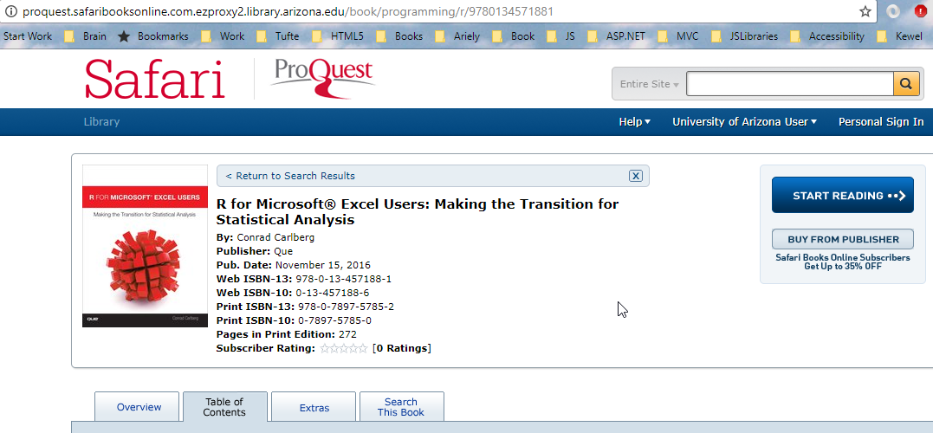
Excel and Stats book-more in depth
Notes:
http://proquest.safaribooksonline.com.ezproxy4.library.arizona.edu/book/programming/r/9780134571881

Slide 9
Goals Basic- Tour of RStudio
Project
Console
Vectors
Variables
Source
Files
Packages
Help
Viewer
History
Intellisense
Cheat Sheets

Slide 10
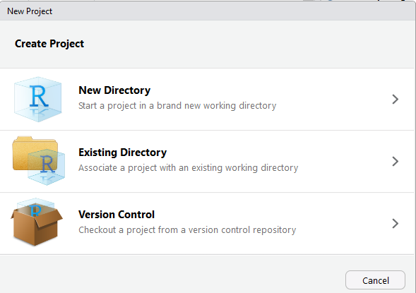
Project (Play along)
File→ New Project…

Slide 11
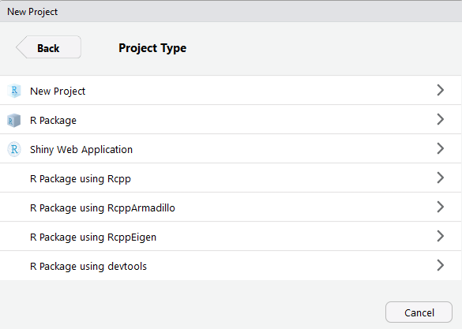
Types of New Projects

Slide 12
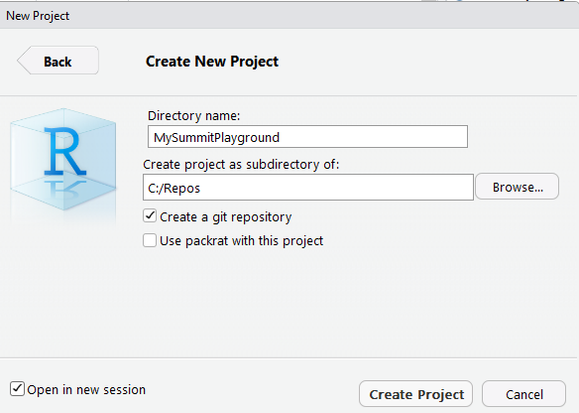
Give it a name

Slide 13
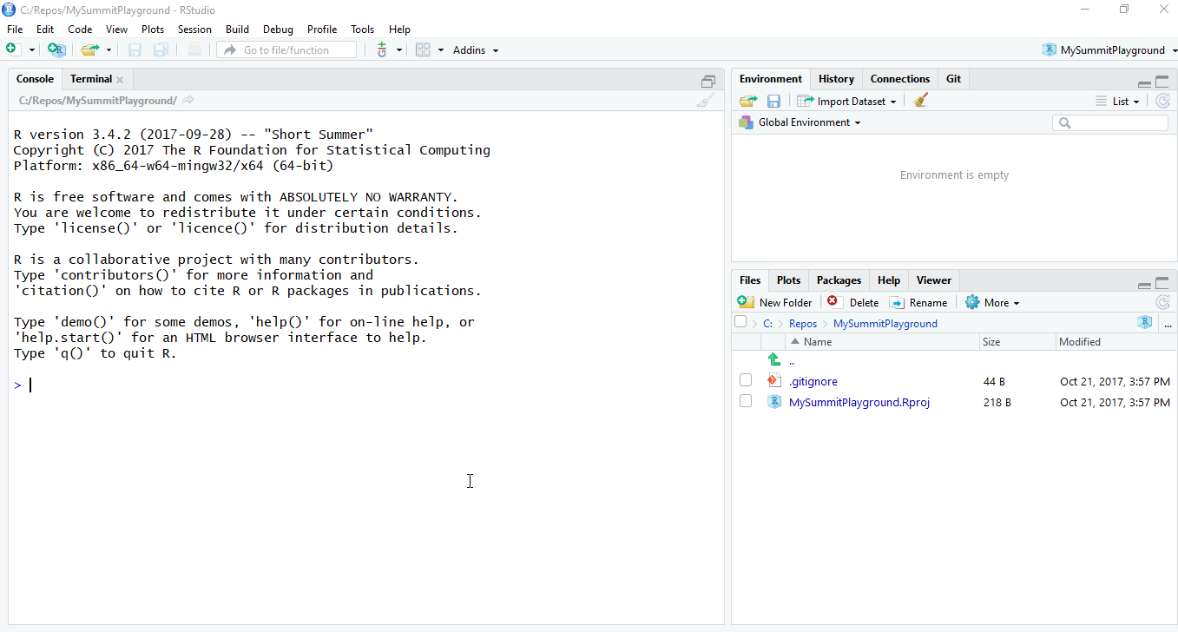

Slide 14
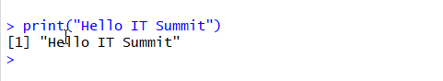
Console
Console is like DOS or Terminal or Shell
Try the following:
What happens if you don’t use quotes?
What happens if type “prin” and tab?
Notice the [1]-we will talk about it later

Slide 15
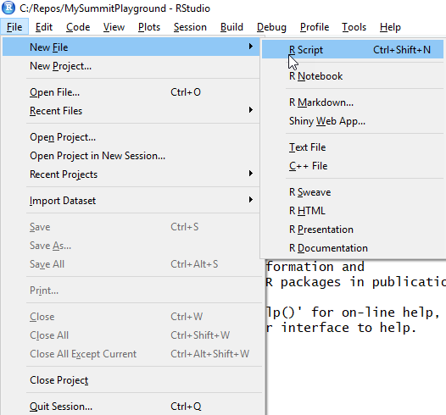
Let’s create a new file

Slide 16
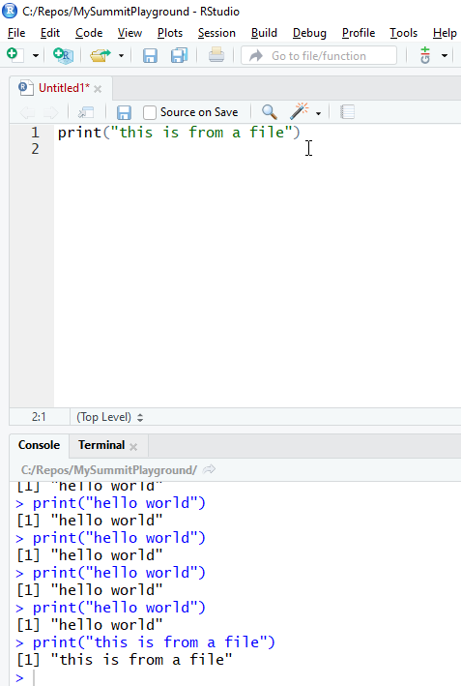
Run a command in source view
Type
print(“this is from a file”)
<control-enter>

Slide 17
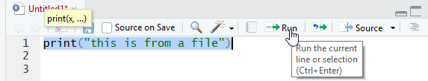
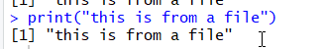
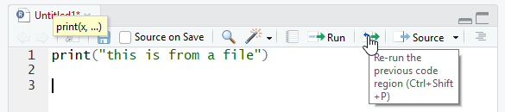
You can also run select and “Run”

Slide 18
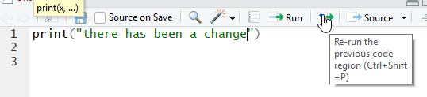
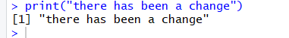
You can change and re-run

Slide 19
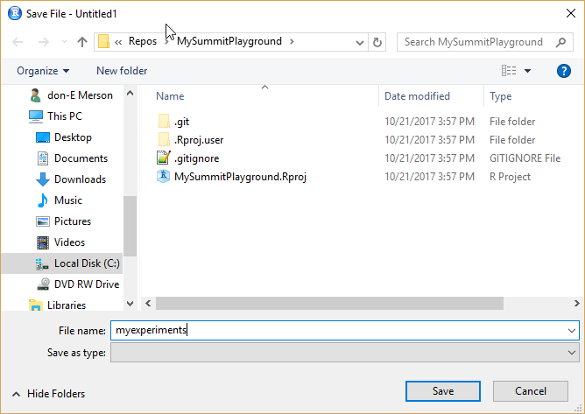
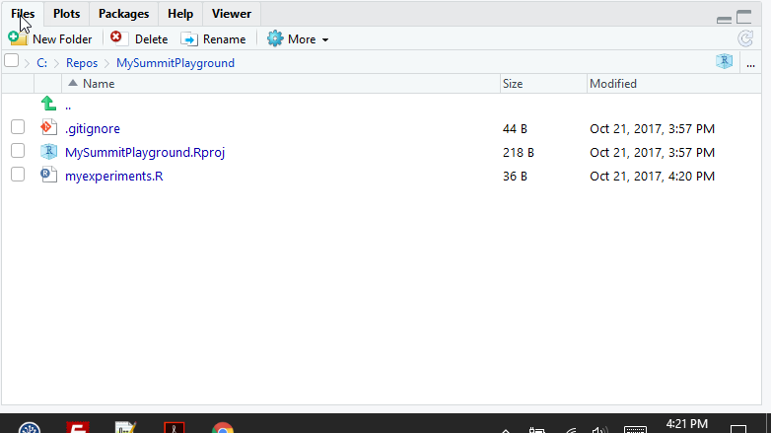
Files
Save the file

Slide 20
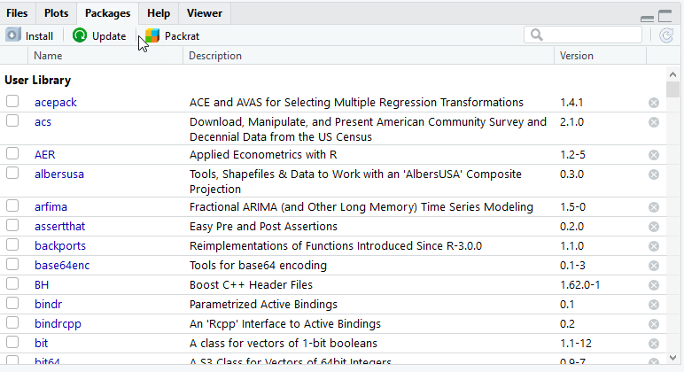
Packages

Slide 21
What is a package?
“Packages are collections of R functions, data, and compiled code in a well-defined format. The directory where packages are stored is called the library. ”-Quick R Web Page
Excel -> R Function =same idea
Data -> values in a defined format
Compiled code-> just means R can run it
Notes:
https://www.statmethods.net/interface/packages.html

Slide 22
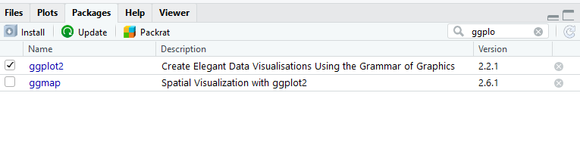
Many ways to load packages
Click on item in Package View if you already have them installed
Use the library() command

Slide 23
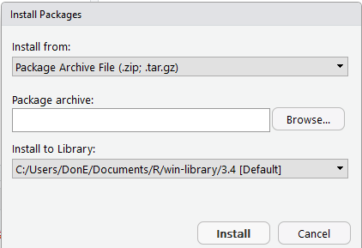
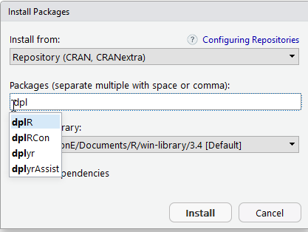
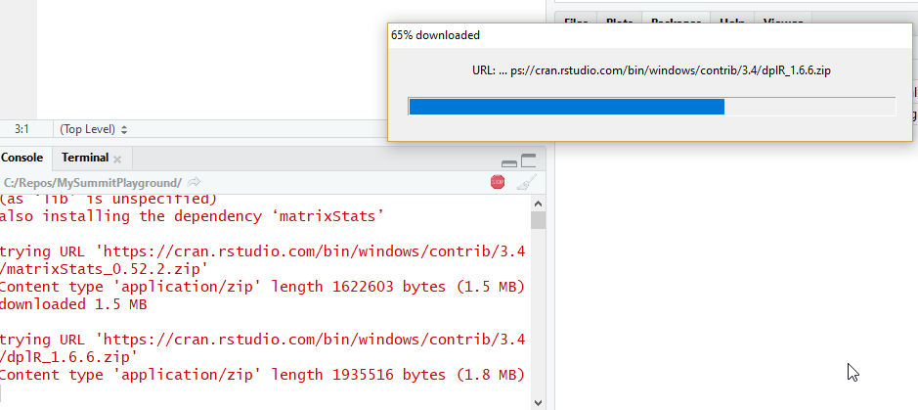
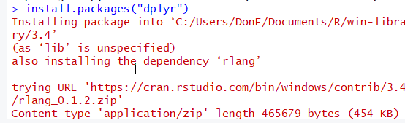
Many ways to install packages

Slide 24

Break

Slide 25
Goals-Quick Tour (cont)
Using variables
What is shown in the environment tab
What are common types in R
How to create a function
Viewer
Help
Options

Slide 26
Variables
A variable is a container where you can store some type of value, function, or data
You can set them by variableName =“Value”
Or variableName <- “Value”
The second is more common in R
Try to use second form as sometimes first form doesn’t work

Slide 27
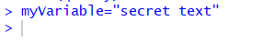
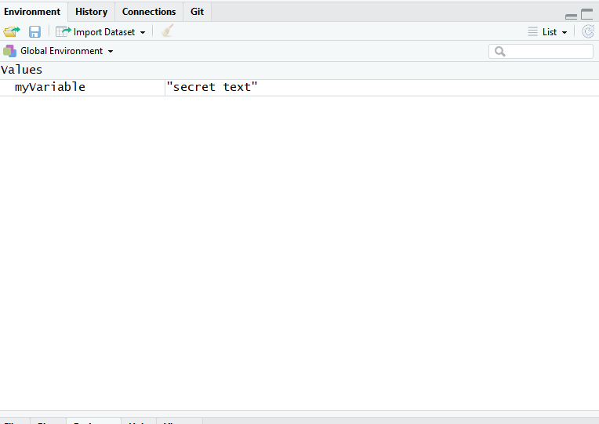
Environment
Type in console

Slide 28
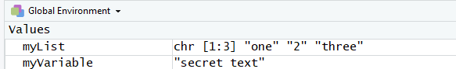
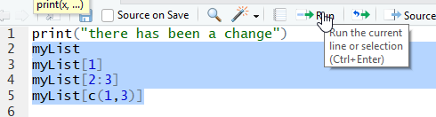
List variables
Type
This creates ->
Type and Run the following

Slide 29
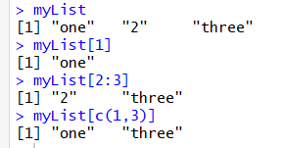
Vector victor
The [1] means it is the first of a vector
For vector think row in Excel
This is a row of 3 items in 1 column

Slide 30
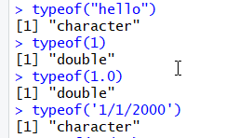
Types
Types defined what operations can be used on data in a variable
Numbers have operations like add, subtract,…
Dataframes have operations like filtering and sorting
Can use typeof command

Slide 31
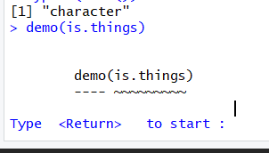
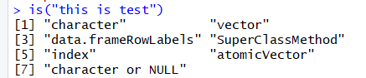
Time to explore

Slide 32
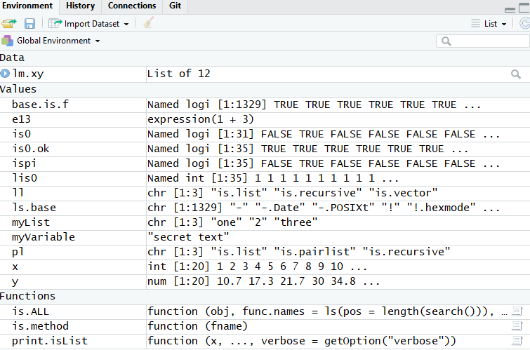
Environment filled up

Slide 33
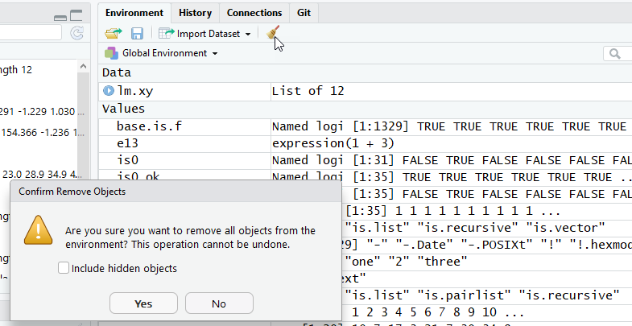
Clear it out

Slide 34
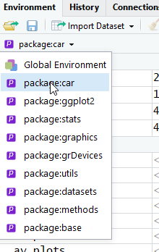
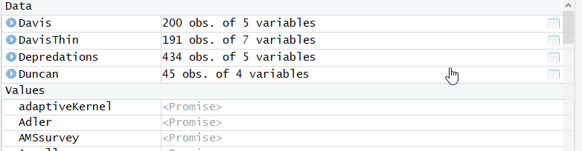
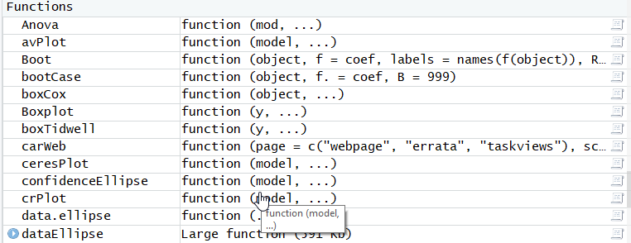
Let’s look at car package

Slide 35
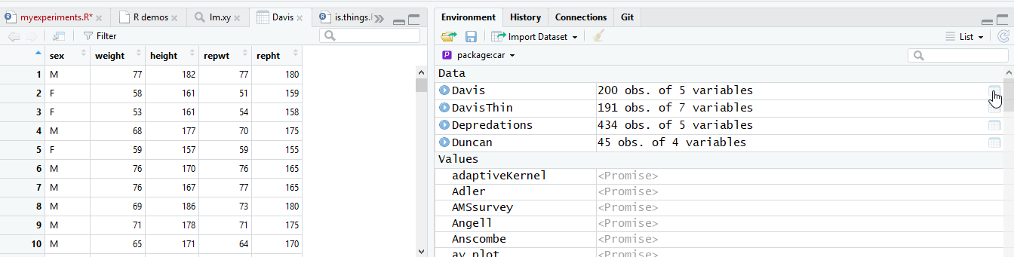
View(Davis)

Slide 36
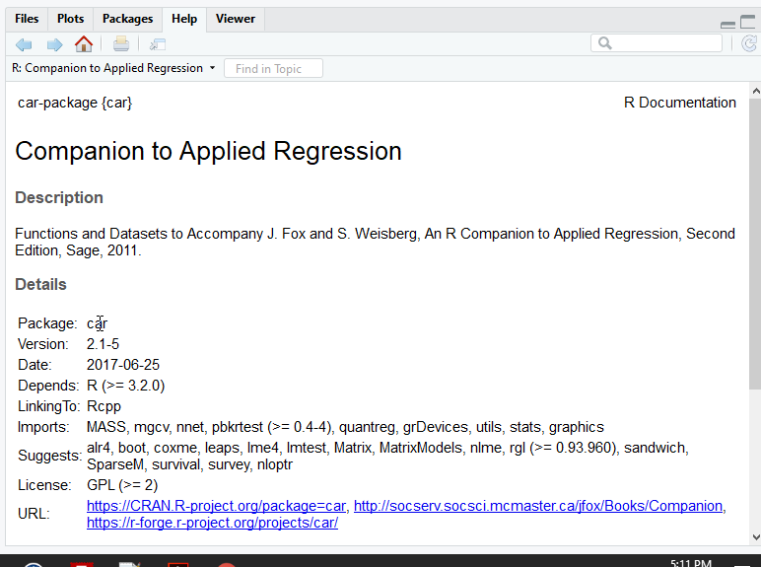
Help
Type

Slide 37
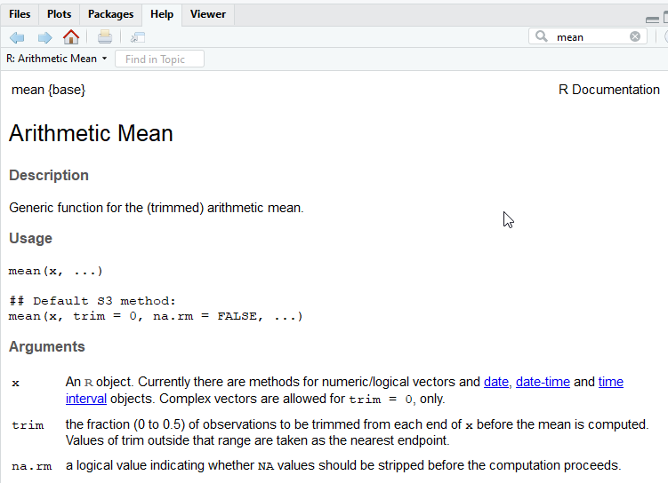
Search Help

Slide 38
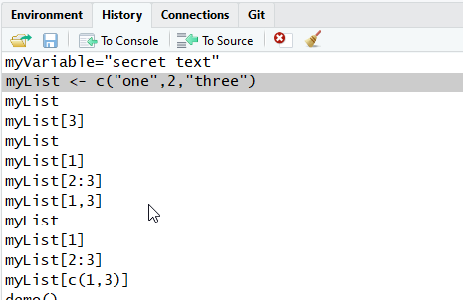
History
You can use up-arrow on keyboard to get previous values

Slide 39
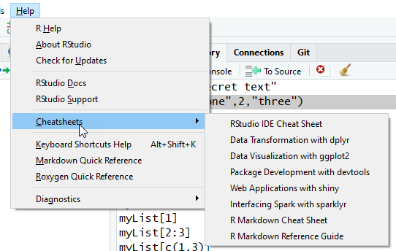
Cheat Sheets

Slide 40
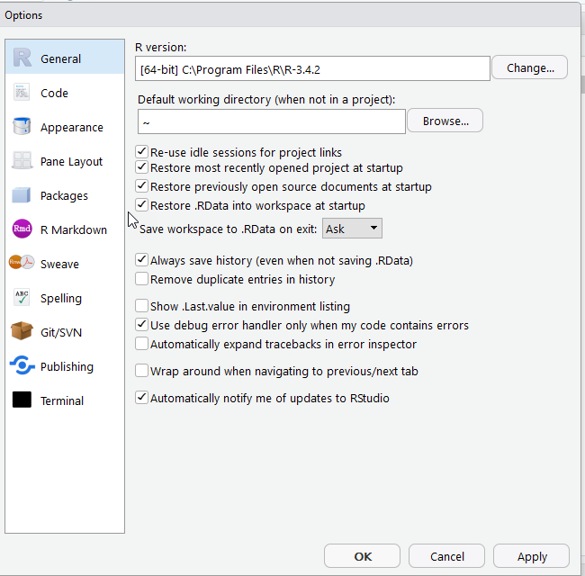
Global Options

Slide 41
Project Options

Slide 42
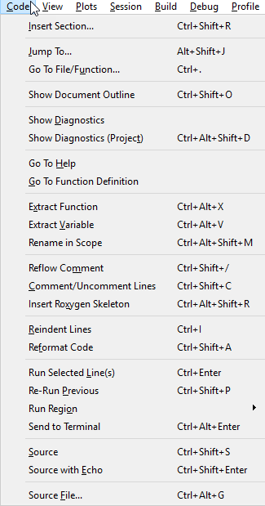
Code Menu
Comment in R is #

Slide 43
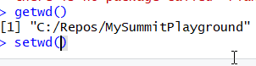
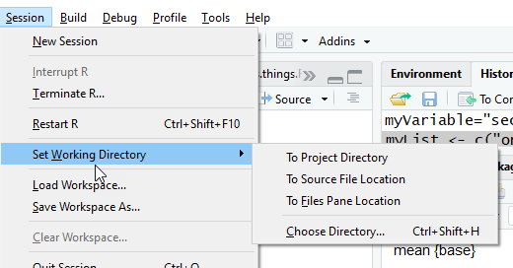
Session and Working Directory
getwd()

Slide 44
Break

Slide 45
Module 2 Goals
Data Types
Vectors
Matrixes
Lists
Tibbles and DataFrames
Import and Export Data
Data Provenance
Viewing Data in R
Display columns of DataFrames

Slide 46
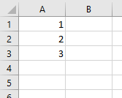
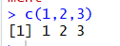
Understanding R from Excel
Vector in Excel
3 rows in 1 column

Slide 47
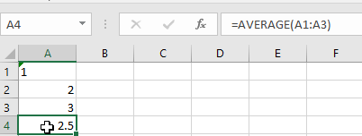
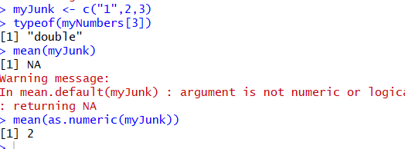
Type in Excel vs. R
Ignores text
In R converts to first value

Slide 48
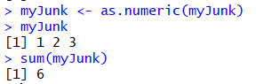

Vectors in R
Allow quick transformations

Slide 49


Can run operations on each item
Vector operations like multiply
Different from aggregates like sum
Summarize into single value (vector of 1)

Slide 50

na =NULL

Slide 51


Matrix
Excel is Column-Row (B2)
R is row-column[3,2]

Slide 52

Mo’ Matrix
Can get rows or columns
Result is vector

Slide 53

Tables in Excel =DataFrame in R

Slide 54

DataFrame$ColumnName

Slide 55


Import data from Excel

Slide 56

We now have a tibbles
(not a whole lot different but better for technical reasons of conversion)

Slide 57

Factors =categorical variables

Slide 58

Data Provenance
Excel is destructive
Make changes =changes data
R can keep original data
If make mistakes can rerun the script

Slide 59

Other Data Imports- Read(base)

Slide 60


Write and read data csv

Slide 61



Ways to view data

Slide 62


Subseting and filtering

Slide 63


More ways to view data

Slide 64


Filter in View mode

Slide 65


Functions vs Sub
Functions return a value
In R have return statement in parens
Can be on multiple lines

Slide 66

Make your own functions
Pro advice
Do 1 thing
Verify it works (Check it in)
Do the next thing

Slide 67



Make it better

Slide 68
Break

Slide 69
Module 3 Goals
Common datasets in R
Aggregate Functions
Common statistical functions
How to use Apply and Lapply
How to do linear regression

Slide 70



Excel has Analysis add-on

Slide 71



Let’s start with common datasets::

Slide 72

cars
summary
str

Slide 73


Using an aggregate function

Slide 74

Common stat functions
Mode is not present
But easy to create

Slide 75




Max and Min and Range

Slide 76




Variance, Standard Deviation, and Correlation

Slide 77


Diff function

Slide 78

Sampling

Slide 79


T-test

Slide 80



Rank-Column, Apply and Lapply

Slide 81

table

Slide 82



Linear Regression

Slide 83


Multivariate Linear Regression

Slide 84


Other multiple regressions

Slide 85


Dummy Variables

Slide 86



Prediction

Slide 87
Stats Cheat Sheet
https://cran.r-project.org/doc/contrib/Short-refcard.pdf

Slide 88
Break

Slide 89
Module 4 Goals
Main graphics for R
Main statistical plots
How to save images you create

Slide 90
R has lots of graphical packages
lattice
ggplot
Cheat Sheet for ggplot
It is complicated -> Another module
We’ll start with lattice

Slide 91


EDA
Exploratory Data Analysis
John Tukey

Slide 92



Demo

Slide 93



Demo (plotlib)

Slide 94


histogram

Slide 95


More hist instructions

Slide 96



Export graphics

Slide 97

plot

Slide 98




Slide 99








Slide 100


Stem and leaf

Slide 101

abline example
Notes:
http://www.sthda.com/english/wiki/abline-r-function-an-easy-way-to-add-straight-lines-to-a-plot-using-r-software

Slide 102



boxplot

Slide 103


density

Slide 104



Slide 105



Slide 106



Slide 107


scatterplot
Notes:
https://www.statmethods.net/graphs/scatterplot.html

Slide 108


Scatterplot matrices (pairs)

Slide 109
Break

Slide 110
Module 5 Goals
What is dplr?
What is dplyr a good data solution?
What are single table functions in dplyr?
What are aggregate functions in dplyr?
What are the different joins?
What is dfsql?

Slide 111
dplyr
Package to manipulate data similar in consistent way
Table is tibble
After transformation is still tibble
Other packages
Matrix ->operation >Vector

Slide 112


Consistency allows tricks
These are the same
Assumes results is first parameter to next function

Slide 113


flights

Slide 114
What items are incorrect type?
What is a type?
How about year, month, and day?
What are pros and cons?
How about carrier, origin, and dest?
What are pros and cons?

Slide 115


Converting type for data

Slide 116

dplyr operations on one table
https://cran.r-project.org/web/packages/dplyr/vignettes/dplyr.html
Notes:
https://cran.r-project.org/web/packages/dplyr/vignettes/dplyr.html

Slide 117

Group operations
Notes:
https://cran.r-project.org/web/packages/dplyr/vignettes/dplyr.html

Slide 118


Combing columns

Slide 119

Getting data to join
https://data.world/ian/united-states-university-rankings/workspace/file?filename=TICAS+Percentage+of+2015+Graduates+with+Debt+and+Average+Debt+of+those+with+Loans%2C+by+State.xlsx
Notes:
https://data.world/ian/united-states-university-rankings/workspace/file?filename=TICAS+Percentage+of+2015+Graduates+with+Debt+and+Average+Debt+of+those+with+Loans%2C+by+State.xlsx

Slide 120

Joining tables
inner_join
left_join
right_join
full_join

Slide 121


Think about it first
How many records on inner join vs. full join

Slide 122

Inner join
50 records

Slide 123

Left join
50 records

Slide 124

Right join
51 Records

Slide 125

Full Join
51 records

Slide 126
Seamless inner join
If name is the same will auto connect

Slide 127


sqldf
Can translate to sql
Allows for multiple table join

Slide 128

SQL Keywords

Slide 129
SQL Keyword
Select
Column names (case sensitive)
From
Tablename
Join to another TableName
On
Value on left and on right
Use table.columnname
Where
Columnname =value

Slide 130
Break

Slide 131
Module 6 Goals
What is the Grammar of Graphics in ggplot?
What is the central metaphor?
Why are ggplot graphics more difficult to create at times?
What is a fast way to create ggplot graphics?
What is a facet?

Slide 132
What is Grammar of Graphics?
Different components to graphics
Data and aesthetic mappings
Geometric objects
Scales
Facet specifications
Statistical transformations
Coordinate system

Slide 133

Graphics are built upon layers
Data and mapping
Statistical transformation
Notes:
http://byrneslab.net/classes/biol607/readings/wickham_layered-grammar.pdf

Slide 134

Example Time
ggplot ->create new graphic object
+ layer( …) -> add a layer
The data is diamonds dataset
Map carat to horizontal
Map price to vertical
geom -> display as points in the given position
These are continuous points
Use a Cartesian coordinate system

Slide 135

Another way to write it

Slide 136

The result

Slide 137


Geometric objects

Slide 138


qplot

Slide 139


qplot facets

Slide 140

What are examples of facets?
Need to be categorical variables
How large should they be?
Examples in University data

Slide 141


qplot -ERROR

Slide 142

Box and jitter

Slide 143



Slide 144

Cheat Sheet

Slide 145
Break

Slide 146
Module 7 Goals
Types of file formats used by R
R-Markdown
Publishing documents
Shiny apps
Tufte and tufte handbooks

Slide 147

R has many different formats
We have been using R Script (Source)

Slide 148
R Notebook
Combines Text and Code and results
Use Markup language
Easier version of HTML
Cheat Sheet!

Slide 149


Slide 150

Run chunk 1

Slide 151

Many ways to Run

Slide 152

Can preview document
Many different formats

Slide 153

Preview

Slide 154




Publish
Aft

Slide 155

Publish Details
You will probably need to setup account

Slide 156

Published!

Slide 157


You can republish updates.

Slide 158

R Markdown

Slide 159

Can output multiple formats

Slide 160

Can make presentations

Slide 161

Knitr makes the presentation

Slide 162

Shiny are interactive html apps

Slide 163

Interactive HTML and R

Slide 164


Install tufte
Can make handbooks based on style of Edward Tufte

Slide 165



Create a Tufte Handout

Slide 166

Tufte Book/Handout

Slide 167

Tufte HTML

Slide 168


R Documentation

Slide 169

Thanks all folks!
Notes:
https://www.google.com/url?sa=i&rct=j&q=&esrc=s&source=images&cd=&cad=rja&uact=8&ved=0ahUKEwjU3KKX0IrXAhWoqFQKHWaAAosQjBwIBA&url=https%3A%2F%2Fi.ytimg.com%2Fvi%2F0FHEeG_uq5Y%2Fmaxresdefault.jpg&psig=AOvVaw0h3wQ7S7UBy_epE-LMg96y&ust=1508981472239086

